Slide 1
monograph

Slide 2
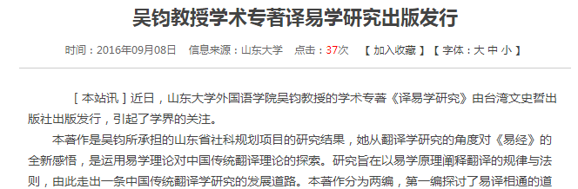

Slide 3


Slide 4


Slide 5
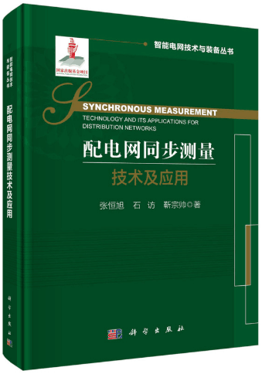

Slide 6


Slide 7
What is monograph?
Types of monograph
Features of monograph.
Main components of a monograph
Difference between academic articles and monographs.

Slide 8
What is monograph?
1. A monograph is a specialist work of writing on a single subject or an aspect of a subject, sometimes called a scholarly treatise.
2. It is designed to stand alone in most cases, although some are produced with a finite number of volumes.
3. Monographs generally are written by specialist for the benefit of other specialists.
4. Monographs demand the highest standards of scholarship.

Slide 9
5. Their authors must be able to collect, collate（校勘）, analyze, integrate, and synthesize all relevant contributions to the literature of the scientific and engineering journals and to add origin material as required.
6. The value of monographs lies in the coherence and comprehensiveness of the information and knowledge they contain, which is important to the specialized researchers to whom they are directed and, therefore, to the advancement of science.

Slide 10
Monographs
2. Types of monographs
•General monographs (geared towards general readers)
• Scholarly monographs（they are self-contained 独立的, single-volume works or books providing in-depth research into a specialized area of knowledge. They are based on thorough research, offering original insights）

Slide 11
Monographs
3. Features of scholarly monographs
• Academicality
• Creativity
• Authoritativeness
• Comprehensiveness
• Systematicness
• Beyond time and space

Slide 12
4. Main components of a monograph
The author
Title and subtitle
Date of publication (up-to-date)
Dust cover or blurb
Contents page (or chapter headings)
Bibliography and index
Illustrations ( statistics, tables, graphs, diagrams or pictures)
Preface and afterword

Slide 13

Dust cover of a book
Preface of a book

Slide 14
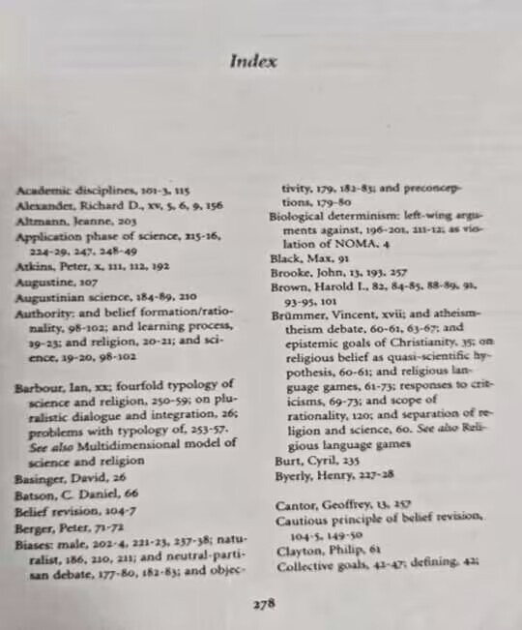
An index lists topics mentioned in the book with page reference.

Slide 15
Monographs
5. Differences between academic articles and scholarly monographs
• Length ( 5000~8000 / 40000~50000)
• Structure(abstract, introduction, research problem, methods, results, discussion and conclusion / The author, Title and subtitles, Date of publication, Dust cover or blurb, Content pages, Bibliography and index, Preface and afterwords)
• Content(hypothesis and evidence / comprehensive and intensive illustration of more issue)

Slide 16
3. Conference documents

Slide 17
Academic conference or symposium
What is it?
a conference for researchers to present and discuss their research subjects
a meeting with the theme of promoting development of science and technology
an important channel for exchange of information between researchers

Slide 18
Classification of conferences
• A+: flagship（一流的 旗舰） conference, a leading venue in a discipline area
• A: excellent conference, highly respected in a discipline area
• B: good conference, well regarded in a discipline area
• C: other ranked conference venues that meet minimum standards
• Unranked: no ranking has been made
• National: run in a country, with Chairs from that country, not well-known to be ranked
• Regional: similar to National but may cover a region crossing national borders

Slide 19
How to find top conferences?
http://www.core.deu.au/conference-portal(国际会议排名系统)

Slide 24
Microsoft Academic

Slide 26
Types of Academic Conferences
Conference
Forum 论坛
Lecture
Panel 分组讨论
Seminar 研讨会
Symposium 专题会议
Convention 例会
Workshop 专题讨论 工作坊
Round table
Poster presentation海报展示

Slide 27
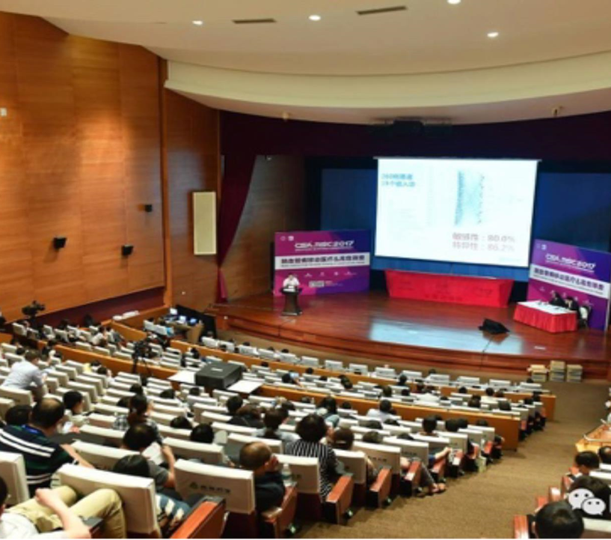

Slide 28
Conference
A conference is a formal meeting in which many people gather in order to talk about ideas or problems related to a particular topic usually for several days. The participants of conferences have similar careers or interests.

Slide 29
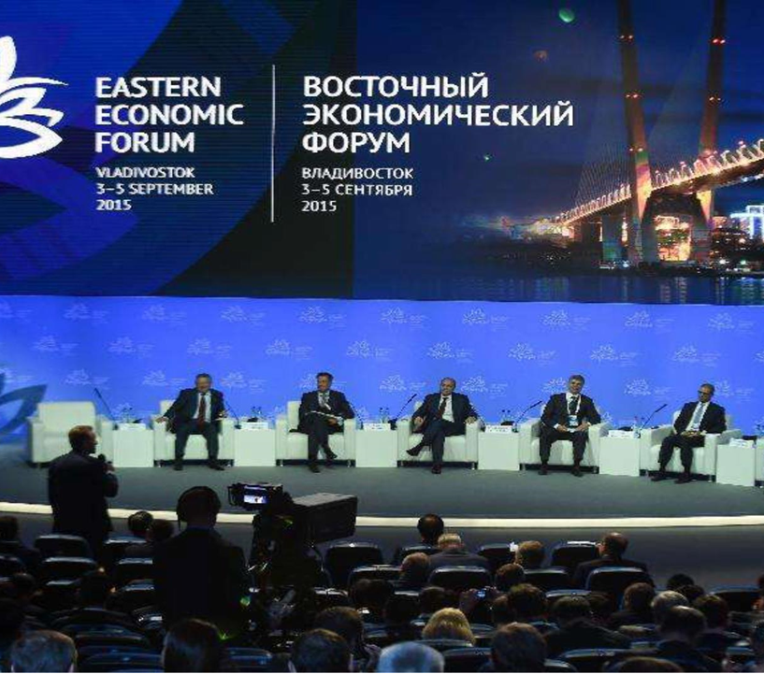

Slide 30
2 Forum
similar to a seminar 研讨会
a public program with panel discussions and audience participation
discussion conducted repeatedly and thoroughly
a debate between two opposite stands on one issue

Slide 31
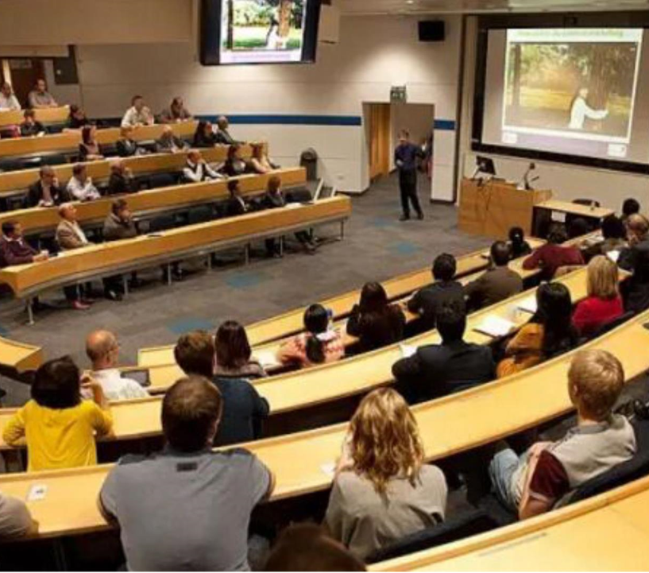

Slide 32
3 Lecture:
simple meeting
an expert lecturing about a specific topic to an audience
no questions to follow

Slide 33
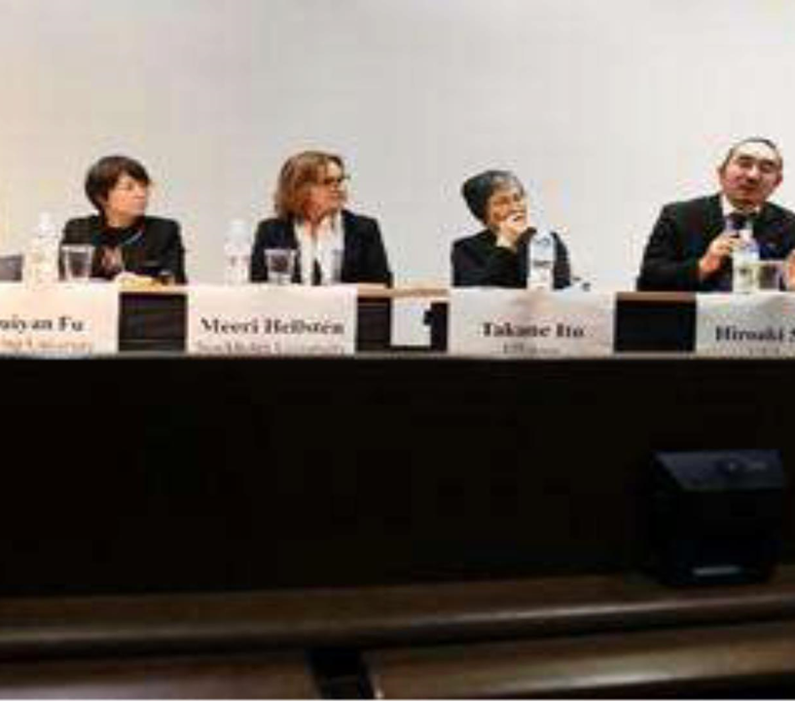
Panel discussion

Slide 34
Type 4 Panel （panel discussion) 分组讨论
a specific format used in a meeting, conference or convention
a live or virtual虚拟 discussion about a specific topic
group of panelists with differing perspectives

Slide 35

Seminar 研讨会

Slide 36
Type 5 Seminar研讨:
a form of academic meeting similar to that of academic instruction
a group of researchers
focusing on particular subject
a seminar leader or instructor
a more formal presentation of research
a place where assigned readings are discussed
questions are raised
debates are conducted

Slide 37
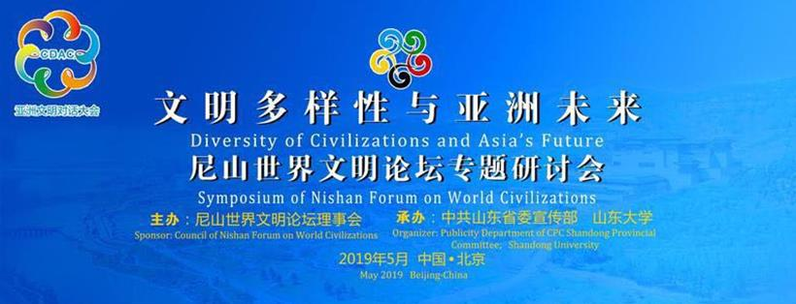
Symposium

Slide 38
Type 6 Symposium专题研讨会:
similar to conference
a formal occasion
a particular area
a subject of interest
more focused on a particular topic
with less attendees

Slide 39
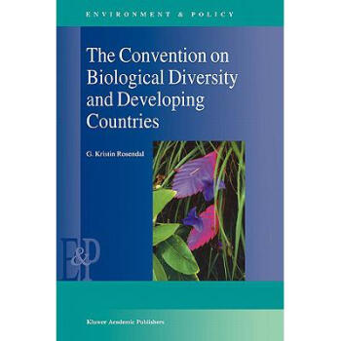

Slide 40
Type 7 Convention例会：
a gathering of individuals
at an arranged place and
discussing or engaged in some common interest

Slide 41
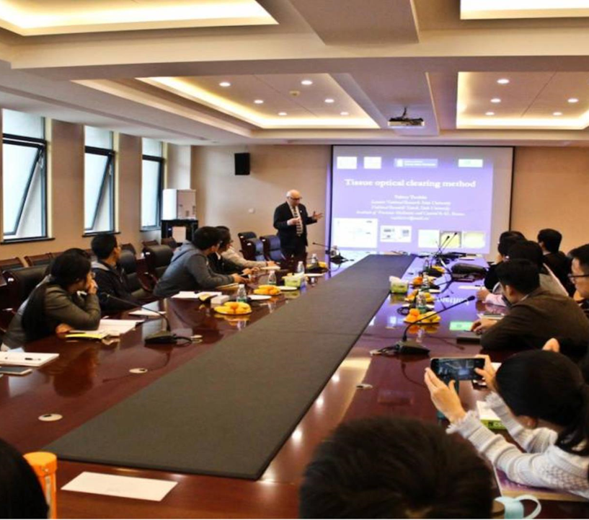
Workshop 工作坊

Slide 42
Type 8 Workshop专题讨论，工作坊:
a short educational program where small groups talk over specific problems
small sessions held during conferences or conventions

Slide 43
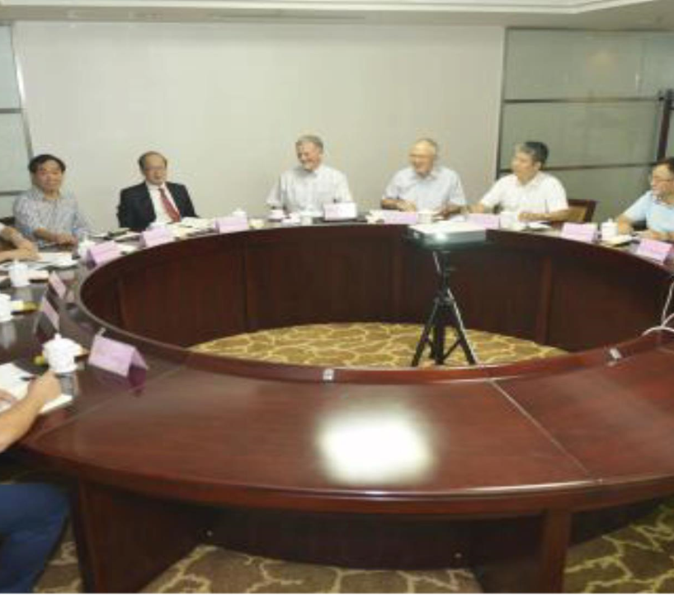
Round table

Slide 44
Type 9 Round table:
a form of academic discussion
on a specific topic to discuss and debate
equal right to participate

Slide 45
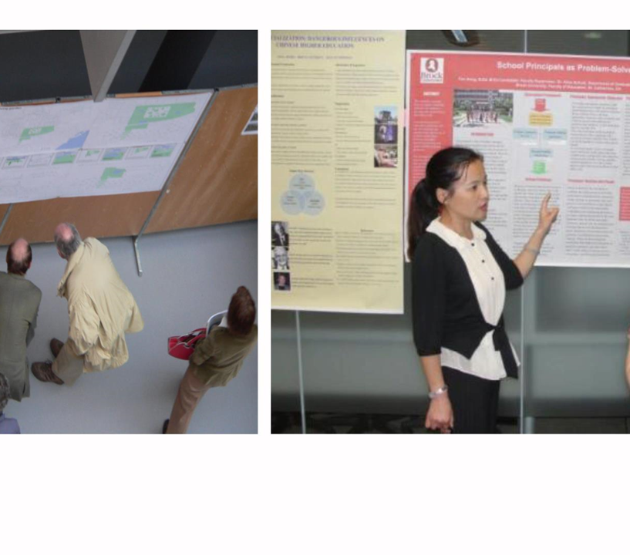
Poster presentation

Slide 46
Type 10 Poster presentation海报展示:
an event where posters are presented
a separate room or area of a trade show floor展览区

Slide 47
Benefits of attending academic conferences
1) You can see what is going on in the field.
2 You may have the chance to build relationships with some researchers in the field.
3) You may have the chance to tell people what you are doing and to find out what other researchers are doing.
Try to find some authoritative conference specific to your own research area.

Slide 48
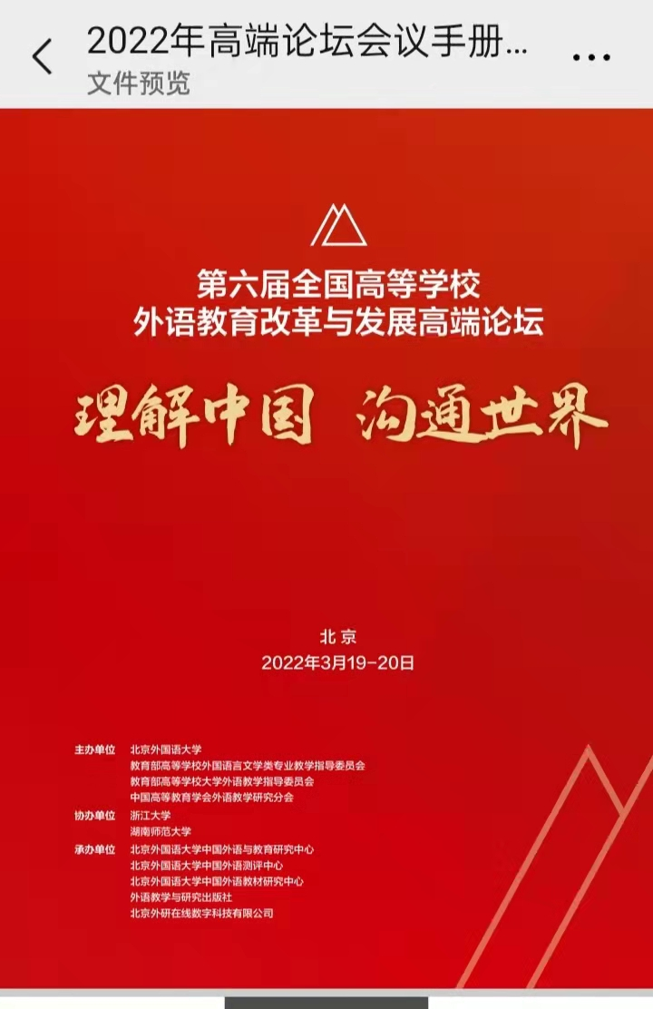

Slide 49
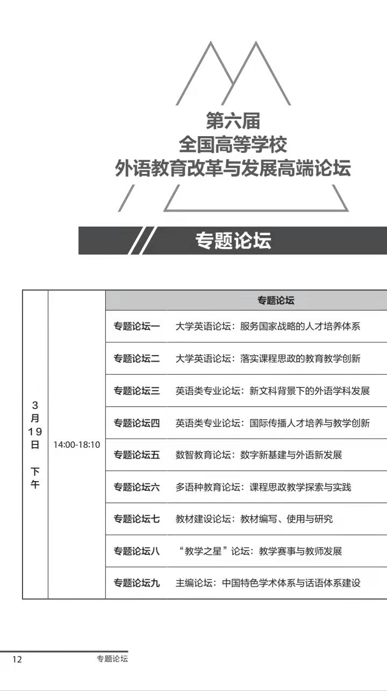

Slide 50
3. Conference documents
What are conference documents? Definition: Printed materials distributed before or at or after a conference, including from the preparation of a conference (announcements公告, arrangements安排, call for papers征文启事, etc.) to the post-conference proceedings and other information .
Features of conference proceedings
• Being new, professional, specific and instantaneous
• Latest discoveries, results, achievements and developing tendencies in the field concerned
• Primary literature
• Not fully acknowledged and accurate, revealing research status
• Important resources for information in new directions of science and technology development

Slide 51
3. Conference documents
Types of conference documents
1 ) Pre-conference documents:
• Announcements（ 公告） • Call for papers （征文启事）
• Instructions for authors （投稿说明）
• Instructions for speakers （发言说明）
• Registration form （注册表单）
• Accommodation registration form （住宿登记表）
• Invitation • Preliminary printed proceedings （会前印刷品）
• Collection of abstracts

Slide 52
3. Conference documents
Types of conference documents
2) Documents distributed at a conference or symposium
• Conference program （会议日程安排）with all sessions, workshops and other social activities listed
• Book of abstracts or conference proceedings （摘要或会议论文集）
• Conference paper abstracts 会议论文摘要
• Conference daily schedules 日常会议安排
• Opening speeches （开幕致辞）
• Closing speeches （闭幕致辞）

Slide 53
3. Conference documents
Types of conference documents
3) Documents distributed after a conference or symposium（post
conference literature）
• Post-conference proceedings
• Special edition of conference documents 专刊
• Conference reports 会议报告
• Transaction 汇编
• Conference promotion 会议推广 会议宣传

Slide 54
4. Graduation Papers 学位论文
Contents
1). Introduction
2). Classification of graduation papers
3). Features of graduation papers
4). Format of graduation papers
5). Master‘s thesis and doctoral dissertation （硕士论文和博士论文）
6). Uses of graduation papers
7). Journal article vs graduation paper

Slide 55
4. Graduation Papers
1). Introduction
• Graduation paper is a kind of research paper that should draw on original conclusion based on information derived from research. Its major purpose is to inform the field experts about its new research findings or achievements, and to demonstrate the author's academic ability in the corresponding field.
• A paper at the doctoral level is called a dissertation, but dissertations and theses are usually referred to collectively as theses

Slide 56
4. Graduation Papers
2). Classification of graduation papers
According to degree
• Graduation paper for Bachelor degree 本科毕业论文
• Graduation paper for Master degree 硕士毕业论文
• Graduation paper for Doctor degree 博士毕业论文
According to research method
• Theoretical paper 理论性的研究论文
• Experimental research paper 实验性的研究论文
• Descriptive research paper 描述性的研究论文
According to the research field:
• Research papers in arts and humanities
• Research papers in science and engineering

Slide 57
4. Graduation Papers
3). Features of graduation papers
• Publication: grey literature
• Originality in contents
• Academicality, novelty, and depth in research
• More references
• Large amount

Slide 58
4. Graduation Papers
4). Format of Graduation Papers
Front Part
• Cover (including the title, author, instructor and his professional title)
• Title page (including the title, subtitle)
• Abstract ( including the problem, the research methods, the results and conclusion as an isolate essay；in both English and Chinese)
• Key words ( describing the main ideas of the essay)
• Declaration of originality and authority 原创性和权威性声明
• Table of contents

Slide 59
4. Graduation Papers
Body Part
• Introduction - explaining the writer's motive, intention and purpose in discussing his or her topic, the methodology, and its scope and focus and significance, together with the background or the situation;
• Literature review - reviewing relevant literature and showing how this has informed the research issue;
• Methodology - explaining how the research has been designed and why the research methods/population/data collection and analysis being used have been chosen;
• Findings -outlining the findings of the research itself;
• Analysis and discussion -analyzing the findings and discussing them in the context of the literature review;
• Conclusion- summarizing the thesis.

Slide 60
4. Graduation Papers
4). Format of Graduation Papers
Ending Part
• References-explaining source of references, basic requirement of academic writing
• Acknowledgement-expressing thanks and gratitude to those who have ever given support to the researcher.
• Note: providing further explanation or interpretation of some concepts, judgement or material mentioned in the article for readers in forms of foot note or end note.
• Publication list: papers published.

Slide 61
4. Graduation Papers
5). Master's thesis and Doctoral dissertation
The words “thesis” and “dissertation” are often used interchangeably, leading to some confusion in academia about what each individual word actually means. The main difference between the two is:
A master‘s thesis must demonstrate that the student knows the background and principal works of the research area, and can produce significant scholarly work. It should contain some original contribution whenever possible. The thesis must have a substantial实质性 research component and a focus that falls within arts and science, and it must be written under the guidance of an advisor. As the final element in the master’s degree, the thesis gives the student an opportunity to demonstrate expertise in the chosen research area.
A doctor’s thesis must contain a substantial contribution of new knowledge to the field of study. It presents the results and an analysis of original research, and should be significant enough to be published.

Slide 62
4. Graduation Papers
6). Uses of graduation papers
For researchers
• to learn about the latest research topics课题
• to learn about the latest research focus热点
• to learn about the research levels
For students
• to select the proper supervisor
• to add references to one’s own paper
• to get familiar with the writing style of graduation papers

Slide 63
4. Graduation Papers
7). Journal article vs graduation paper
Purpose
Content

Slide 64
4. Graduation Papers
3. Length
4. Reference

Slide 65
4. Graduation Papers
5. Detail
6. Evaluation
7. Author
8. Publication Standard

Slide 66
Thank you！

